Slide 1
Motion Detection based Surveillance System
Done by:
S.Sanjana-2019PECCS176
S.Sofiya-2019PECCS192

Slide 2
Problem definition
This work is in the field of video surveillance including motion detection. The video surveillance is one of essential techniques for automatic video analysis to extract crucial information or relevant scenes in video surveillance systems. The aim of our work is to propose solutions for the automatic detection of moving objects in real time with a surveillance camera. The detected objects are objects that have some geometric shape (circle, ellipse, square, and rectangle)

Slide 3
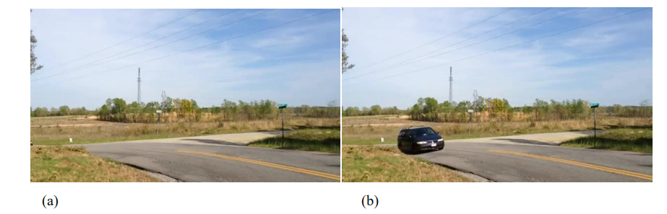
Existing system
CCTV systems (Closed Circuit Television) become usable in several areas of security. CCTV is used mainly for recording daily happenings in a particular place.
Here we can see a basic surveillance camera recording of a car on the road

Slide 4
Proposed System:
The main goal of our miniproject is to provide solutions that detect moving objects with certain geometry in real time. In our project, we seek to propose a method which can reduce the effect of the challenges described above and can run a fairly effective and efficient manner in terms of results and response time. These were done by writing an efficient code in python using OpenCV.

Slide 5
Development environment software requirement: * windows 10 * Jupiter hardware requirement: *4gb ram *60gb memory *camera

Slide 6
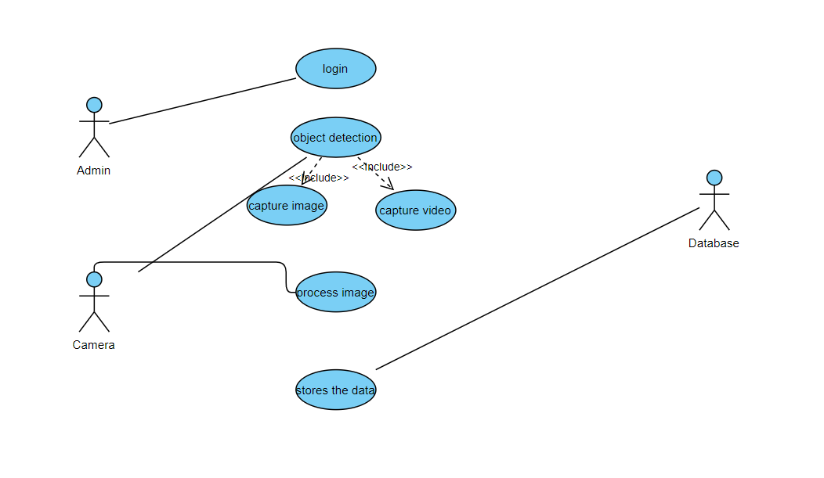
Usecase diagram

Slide 7
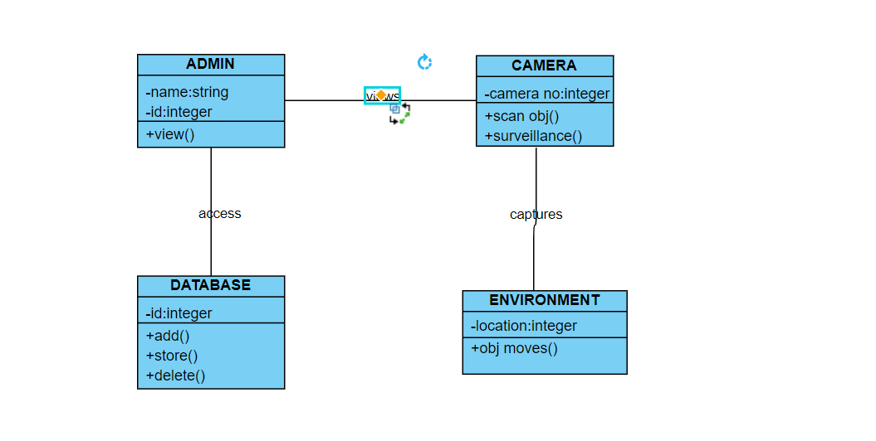
Class diagram

Slide 8
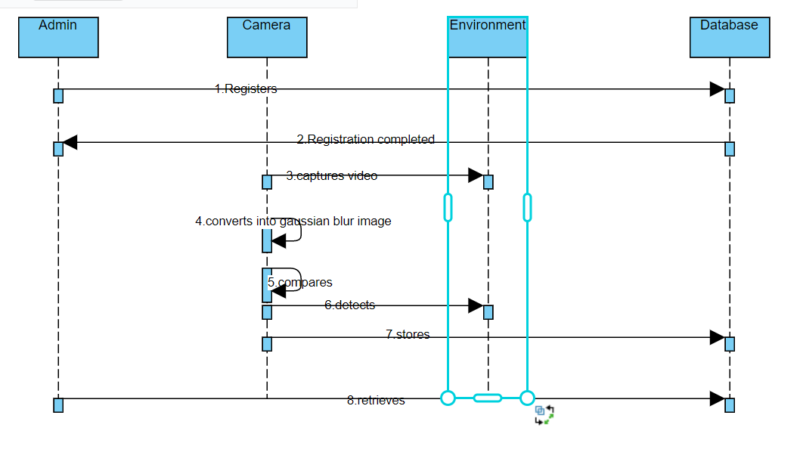
Sequence diagram

Slide 9
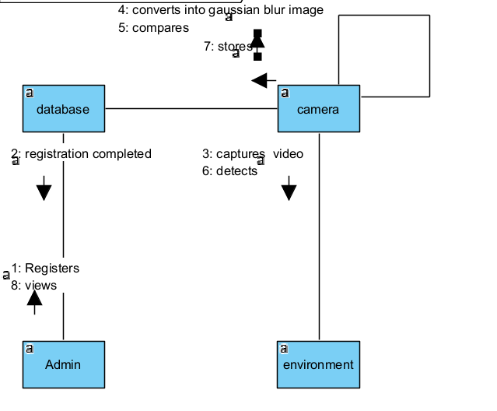
Collaboration diagram

Slide 10
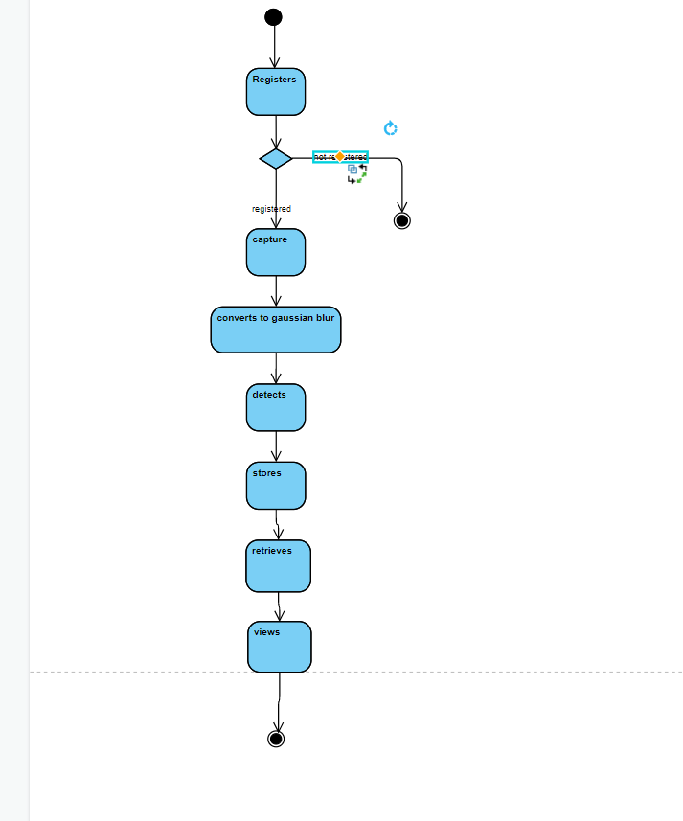
Activity diagram

Slide 11
References
Singh, B., Singh, D., Singh, G., Sharma, N., & Sibbal, V. "Motion detection for video surveillance" 2014 International Conference on Signal Propagation and Computer Technology,pp:193-197,(2014)
)Zarka, N., Alhalah, Z., & Deeb, R.," Real-Time Human Motion Detection and Tracking". 3rd International Conference on Information and Communication Technologies: From Theory to Applications, pp:578-583,(2008)
Tao Jianguo, Yu Changhong, "Real-Time Detection and Tracking of Moving Object," Intelligent Information Technology Application, 2008. UTA '08. Second International Symposium on Volume 2, 20-22 Dec. 2008 Page(s):860 – 863

Slide 12
)Dewan, P.,Kumar, R. "Detection of object in motion using improvised background subtraction algorithm" International Conference on trends in Electronics and Informatics(ICEI),pp:651-656,(2017)
Jichan Lee, Sungsoo Lim, Jun-Geon Kim, Bomin Kim "Moving Object Detection Using Background Subtraction and Motion Depth Detection in Depth Image Sequences " IEEE international symposium on consumer electronics,pp:1-2,(2014)
Zhang, L., & Liang, Y. "Motion Human Detection Based on Background Subtraction" Second International Workshop on Education Technology and Computer Science.
,pp:284-287,(2010)

